Slide 1

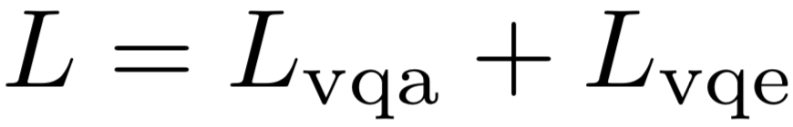
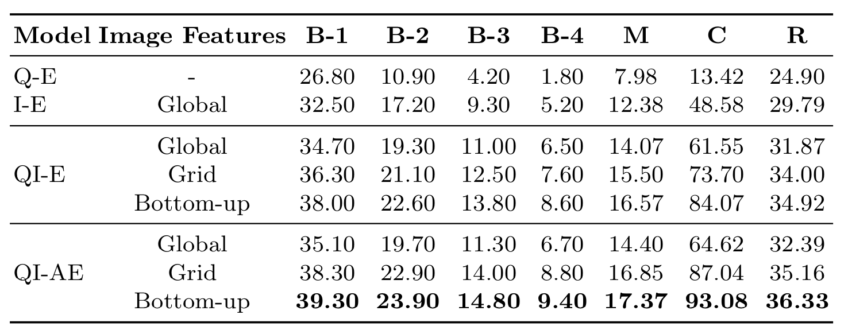
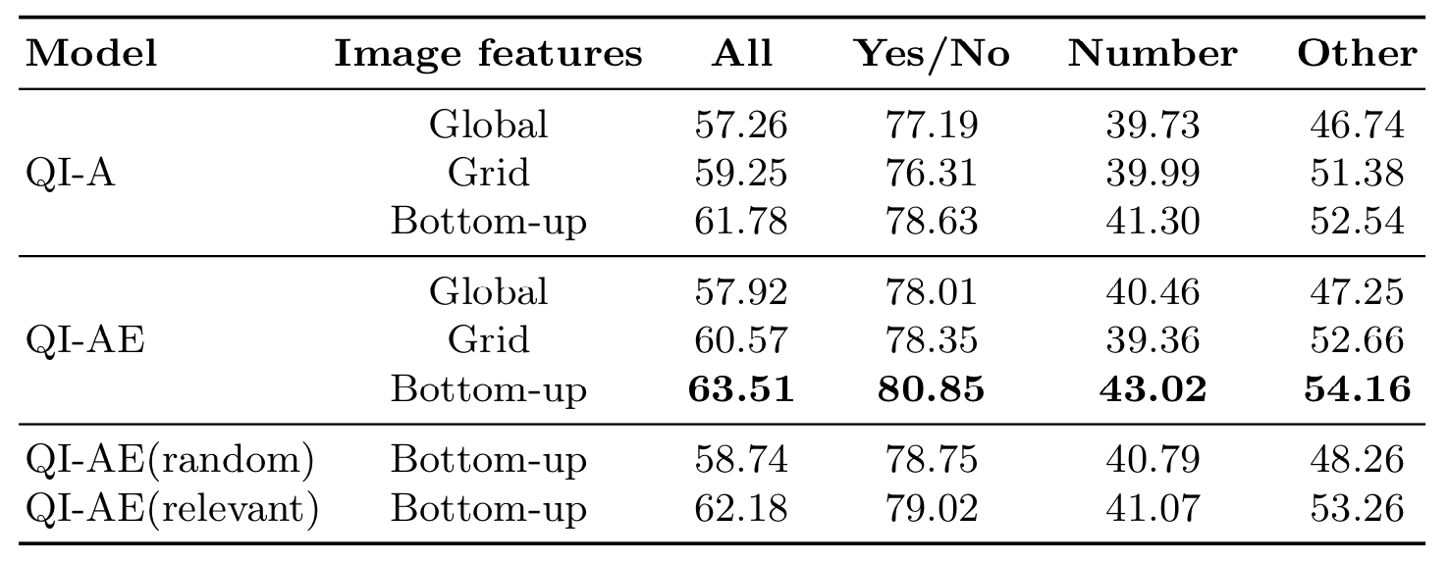
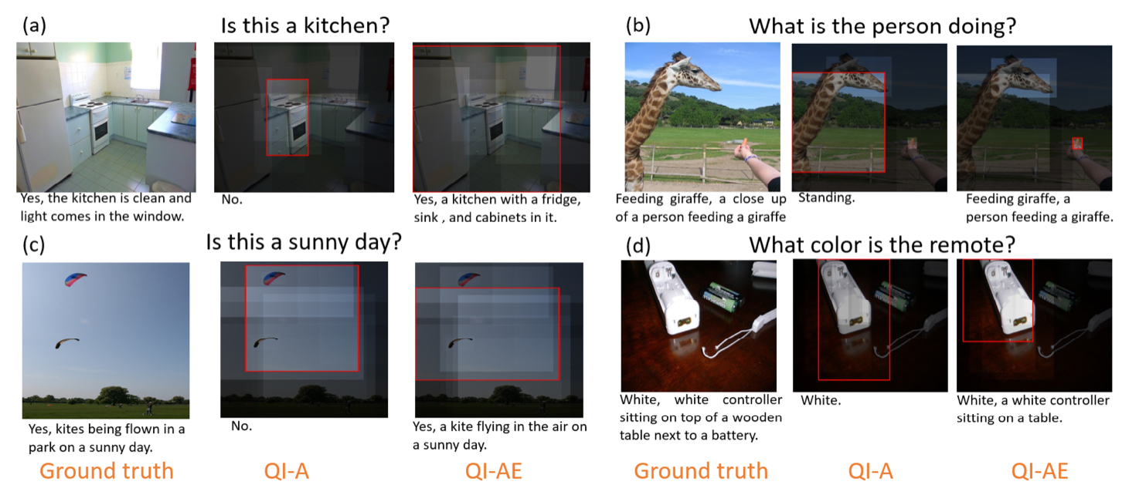
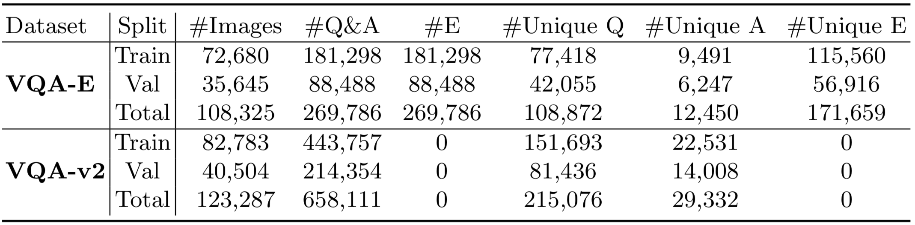
VQA-E: Explaining, Elaborating, and Enhancing Your Answers for Visual Questions Qing Li¹, Qingyi Tao^{2,3}, Shafiq Joty², Jianfei Cai², and Jiebo Luo⁴ ¹University of Science and Technology of China, ²Nanyang Technological University,
³NVIDIA AI Technology Center, ⁴University of Rochester
Introduction
Goal: Generate Textual Justifications for Predicted Answers
Be Accessible to visually impaired people.
Provide beneficial feedbacks that enable the questioners to extend the conversation for effective communication.
Contributions:
Constructed a new dataset with textual justifications for the answers, which is automatically derived from the VQA v2 dataset by intelligently exploiting the available captions.
Proposed a novel multi-task learning framework which can generate a sentence to explain the predicted answer.
Outperformed the state-of-the-art methods by a clear margin on the VQA v2 dataset.
VQA-E Dataset
Multi-task VQA Model
Experimental Results
Explanation Generation Answer Prediction
Explanation Synthesis
Dataset Examples
Dataset Analysis
Insight: the additional supervision from explanations helps the model better localize and understand the important image regions.
Download: https://github.com/liqing-ustc/VQA-E

